Slide 1
Web Development
CSE343
Lab 8

Slide 2
Servers & Nodejs

Slide 3
Agenda
Nodejs
What are servers
Express

Slide 4
Recap
Last time we saw how we can expose functions running on a machine to the world using REST APIs
We also saw how to design a REST API of our own
We saw how the front end can call these APIs using fetch()
This time we will start implementing the backend logic itself

Slide 5
Nodejs – Basics
So far, we have been running javascript in the browser
Node allows us to run javascript on the machine. The same way we run python, C++, Java programs
To get started, install node
Make sure that running node --version doesn’t return with an error

Slide 6
Nodejs – Basics
Node runs the V8 JavaScript engine. This is the engine that runs in the google chrome browser
So, it essentially takes the engine out of the browser and runs it locally

Slide 7
Nodejs – Basics
So, what’s the difference between Node and the browser
Both the browser and Node.js use JavaScript as their programming language
In the browser, most of the time what you are doing is interacting with the DOM using document and window APIs. Those do not exist in Node.js
In Node, you have APIs to interact with the file system

Slide 8
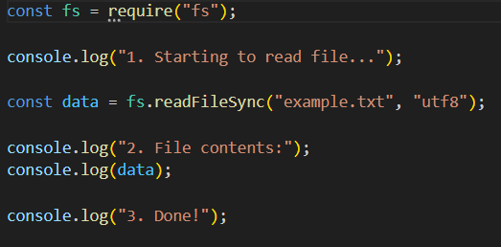
Nodejs – Basics
Let’s take an example of a node program that interacts with the file system

Slide 9
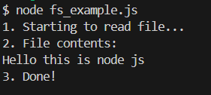
Nodejs – Basics

Slide 10
Nodejs – Concurrency
Many programming languages that we have studied before (Java, Python, …) support multi-threading -> you can simply create a new thread in you program and assign it a task to achieve concurrency
Unlike these languages, node is single threaded
At a first glance, this may sound disastrous!
How can we achieve concurrency??

Slide 11
Nodejs – Concurrency
Before we go into why node can achieve concurrency, let’s first think about some cases where we actually need it
So that’s a question for you: When would we need concurrency?

Slide 12
Nodejs – Concurrency
When would we need concurrency?
If we are running a server, we would want to handle multiple requests at the same time
If we are doing an I/O operation like reading from the disk or sending a network request, we don’t want our entire program to stop and wait for this operation to return
If we are working with a timer, we don’t want our entire program to stop and wait for the time to finish
If there is a long running background process like compressing a file or sending an email

Slide 13
Nodejs – Concurrency
When would we need concurrency?
We need concurrency whenever we want multiple tasks to progress at the same time, especially when some tasks involve slow I/O
A non-concurrent system would freeze whenever it waits for something

Slide 14
Nodejs – Concurrency
> Well, if concurrency is that important, then node is a terrible choice since it is single threaded
No.
Nodejs has a different way to achieve concurrency despite being single threaded

Slide 15
Nodejs – Concurrency
Allow me to introduce you to the Event Loop
This is the heart of Node's concurrency
When Node reaches a blocking call (a call that requires waiting), Node does not execute it in the main thread.
It delegates it to the system where the call is executed by another component called “libuv”, and while waiting, the main thread continues executing other code

Slide 16
Nodejs – Concurrency
When libuv finishes a task, it sends the result back to Node
The event loop then “resumes” the code after the blocking call

Slide 17
Nodejs – Concurrency
Let’s revisit our file system example
This is a synchronous call to the read operation
Meaning that the entire program stops and waits/blocks for the disk I/O to finish before it resumes execution
Let’s make async so that the main thread can execute other code while doing I/O

Slide 18
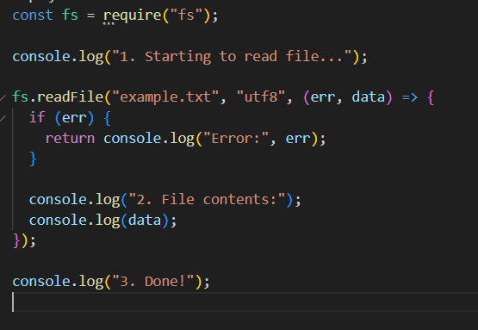
Nodejs – Concurrency
Here we gave it a callback to be executed on the output of the async call
Can you guess the output of the program?

Slide 19
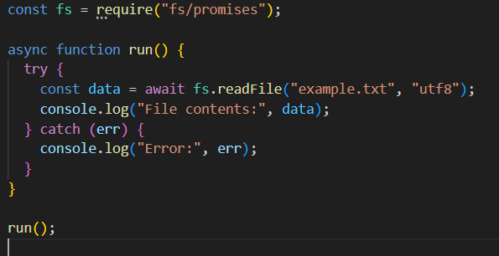
Nodejs – Concurrency
We can achieve the same thing using async/await to avoid callback hell

Slide 20
Nodejs – Concurrency
In summary:
Node achieves concurrency because your JavaScript is single-threaded but the I/O system under it is multi-threaded.
JS delegates slow operations to libuv threads
The event loop keeps your program responsive and allows thousands of concurrent requests

Slide 21
What are servers
Servers are computers that run the backend logic of your application
They expose their functions to the network
They sit waiting for network requests and execute the code according to the incoming request
They return the requested data to the client that sent the request

Slide 22
What are servers
We can create servers in any programming language
We will be using javascript and node today for our server
We will be using ExpressJS: a framework built for node that abstracts and simplifies the process of creating servers

Slide 23

Express
First we need to install express

Slide 24
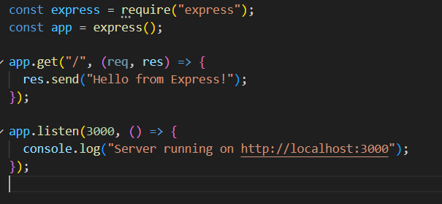
Express
We can create endpoints in express this way:
Here we created our app object
Then created a get endpoint with path “/”
We provide a callback that will be called when we receive a GET request on the path “/”
We finally tell our app to listen for requests on port 3000

Slide 25
Express
The call back is called with 2 parameters:
Req: an object containing data about the incoming request
Res: an object that we can use to make our response

Slide 26

Express
Here’s how we can access path parameters of a request like the id
Using res.send() sends text as the response for the request
We can use res.json(some_object) to convert a javascript object to json and send it in the response

Slide 27
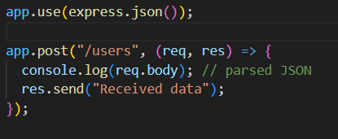
Express
We can add middleware to our express server
Middleware is a function that runs automatically before your logic
This middleware for example:
Parses the json payload of the request into a javascript object

Slide 28
Express
Let’s try to implement the REST API that we designed last time for the mini-twitter project
For now, we can use javascripts arrays to store the data

Slide 29
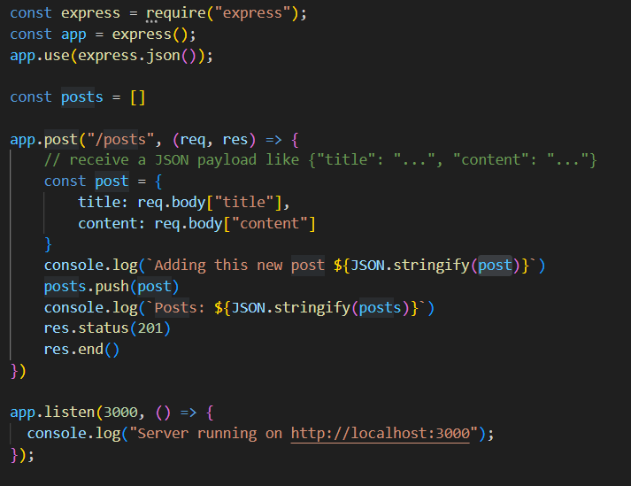
Example for the POST /posts endpoint

Slide 30
Task
Implement the remaining endpoints in the REST API using javascript arrays and objects for storage

